Slide 1


Capstone Project Azure – Batch G2 Check Point 2
14th March 2022

Slide 2
Contents
Case Study – Introduction
Check Point 2 – Approach
Task 2.1(Visualization using Python)
Task 2.2 (Exploratory Data Analysis)
Task 2.3 (Visualization using Power-BI)
Task 2.4 (Model building using ML algorithms)
Team Contribution
Group Members

Slide 3
Case Study - Introduction
Column Name | Description
Sales_ID | Sales ID
Name | Name of the used car
Year | Year of the car purchase
km_Driven | Total km driven
Region_Code | Code representing unique Region name
City_Code | Code representing City
State_Code | Code representing unique state name
Postal_Code | Postal code of the area
Fuel | Fuel type
Seller_Type | Who is selling the car
Transmission | Transmission type of the car
Owner | Owner type
Mileage | Mileage of the car
Engine | engine power
Max_Power | max power
Seats | Number of seats
Sold | used car sold or not
Target Column | Description
Selling_Price | Current selling price for used car
Domain: Automobile Industry
About: The XYZ automobile company in India wants to enter the business of selling used cars. They would like to analyze the business challenges before the venture.
Challenges: They want to understand the factors affecting the pricing of cars in the market, since those may be very different from the new car market. Essentially, the company wants to know:
Which variables are significant in predicting the price of a used car?
How well those variables describe the price of a car
Based on various market surveys, the consulting firm has gathered a large dataset of different types of used cars across the market.
Data Dictionary: Refer to the table.

Slide 4
Check Point 2 – Approach
Task 2.1, 2.2 and 2.4 – Approach
Task 2.3 – Approach

Slide 5
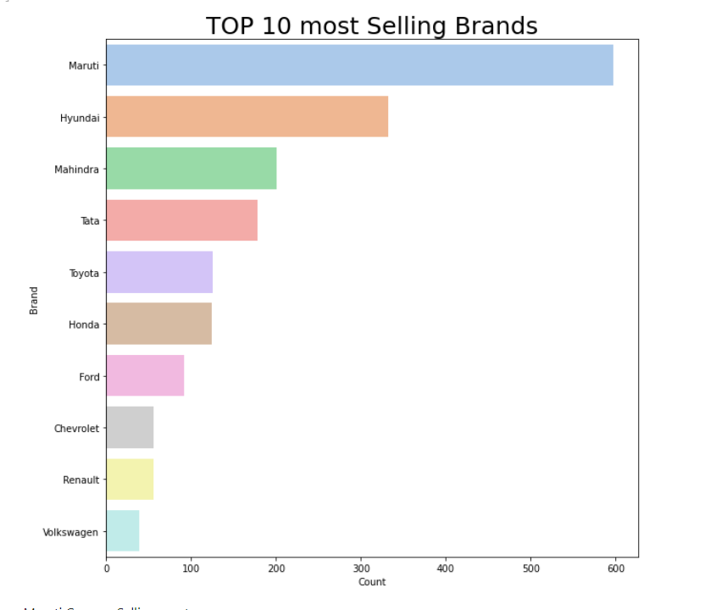
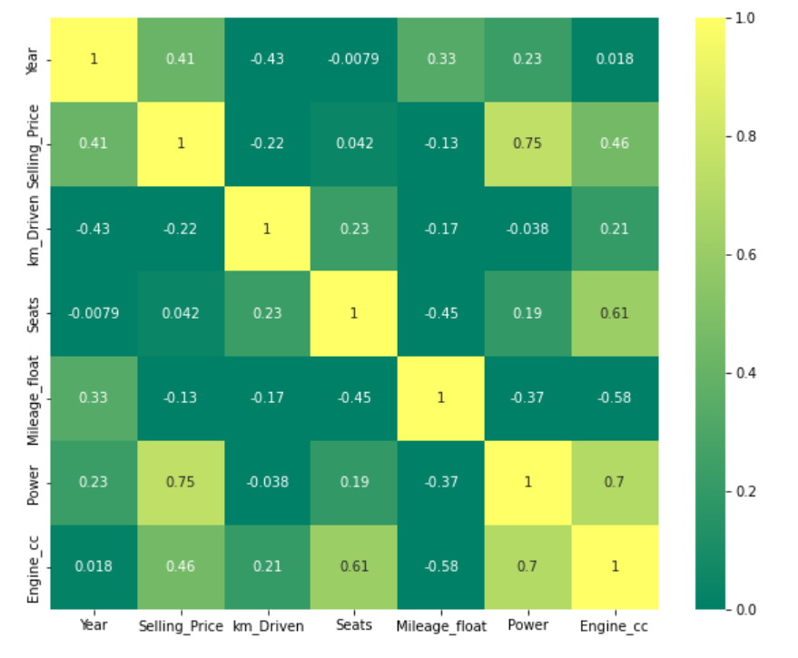
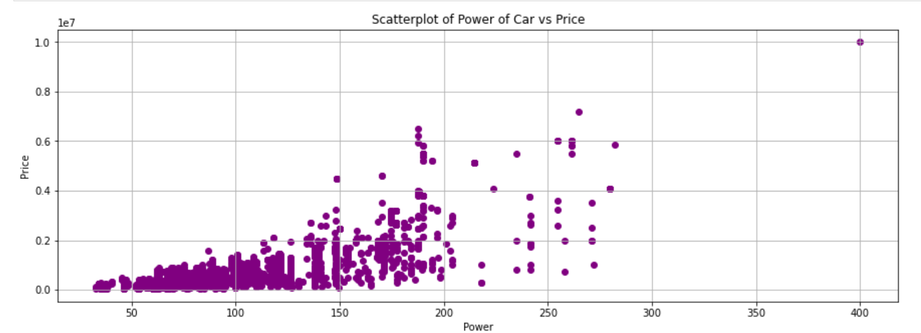
Task 2.1(Visualization using Python)
Q1. Which variables are significant in predicting the price of a used car?
Using Correlation Matrix, we conclude that Power is related to the Selling Price.
Q2. How well those variables describe the price of a car?
With the Increase in the Power Selling Price of cars are also increasing.
Q3. Which brands are selling most ?
Maruti cars are selling the most

Slide 6
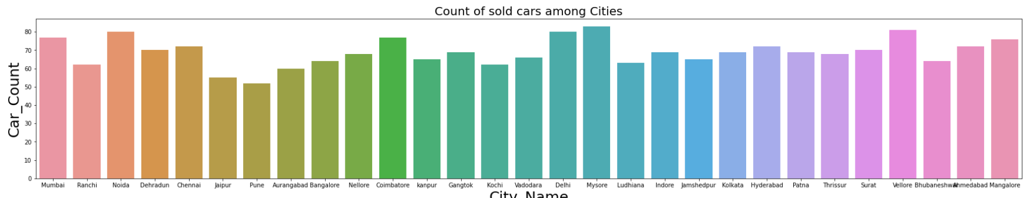
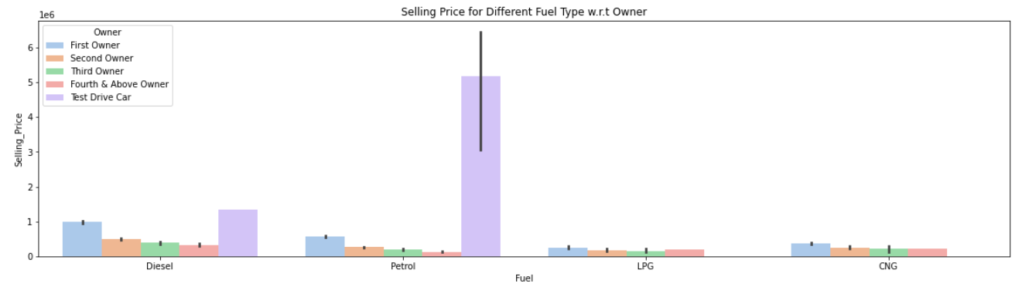
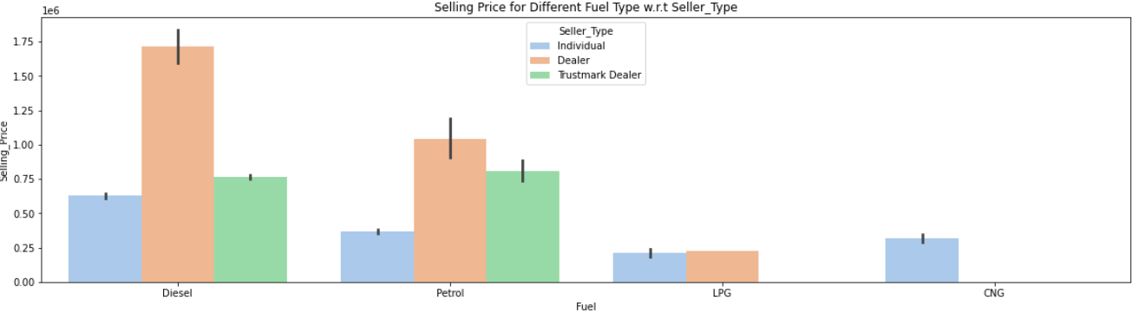
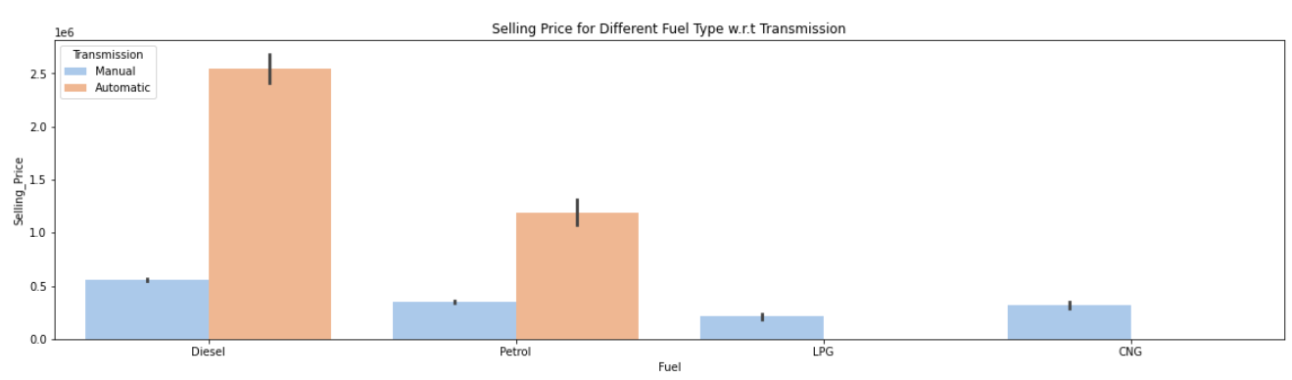
Task 2.1(Visualization using Python) (Cont..)
Q4. Are there specific locations selling more?
In Mysore City Selling of cars is more.
Q5. Which factors are more important in deciding cars' selling price? Ex. kms driven or type of owner or fuel type ?

Slide 7
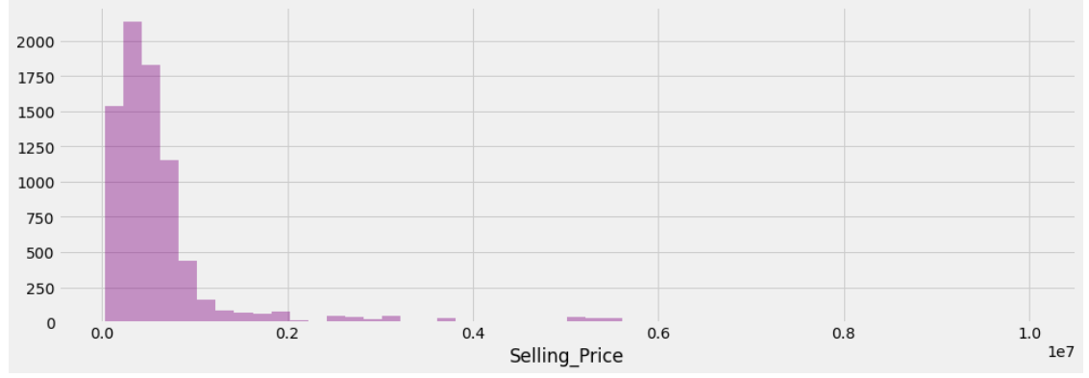
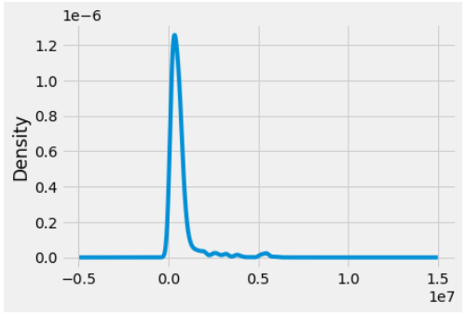
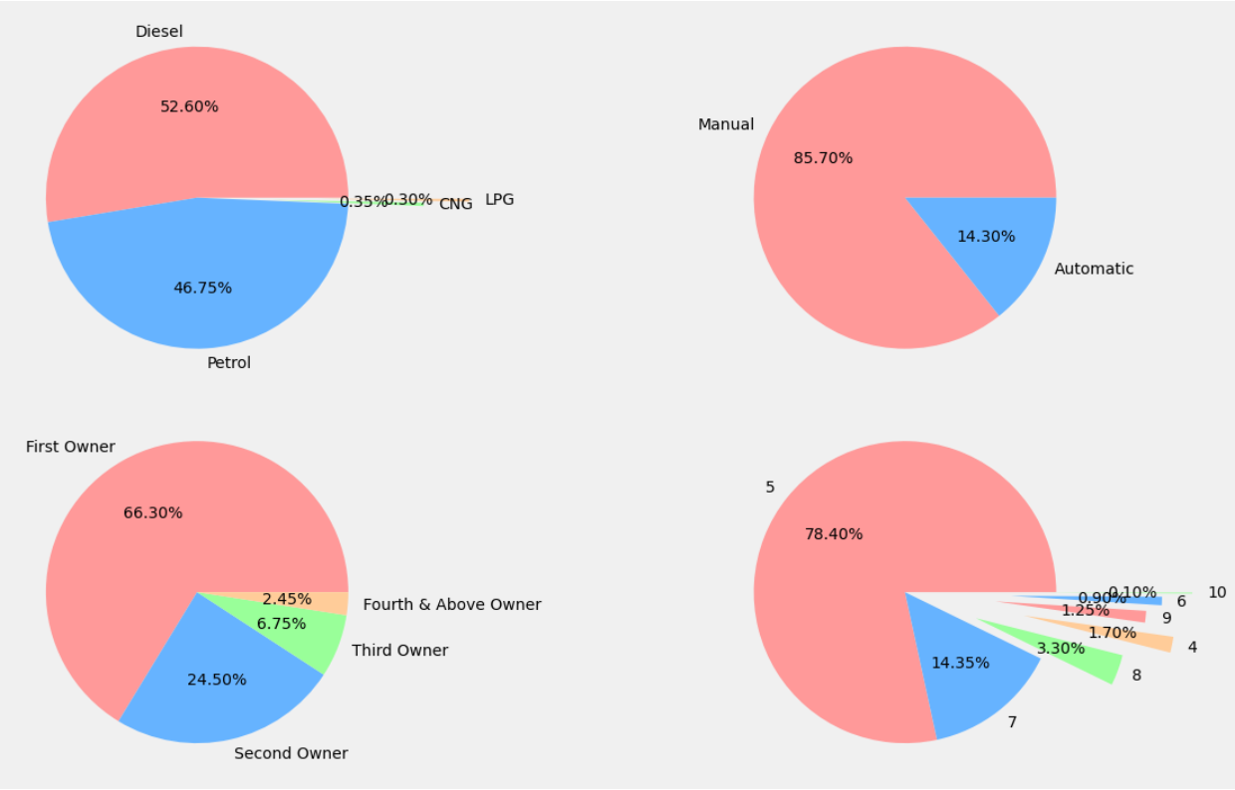
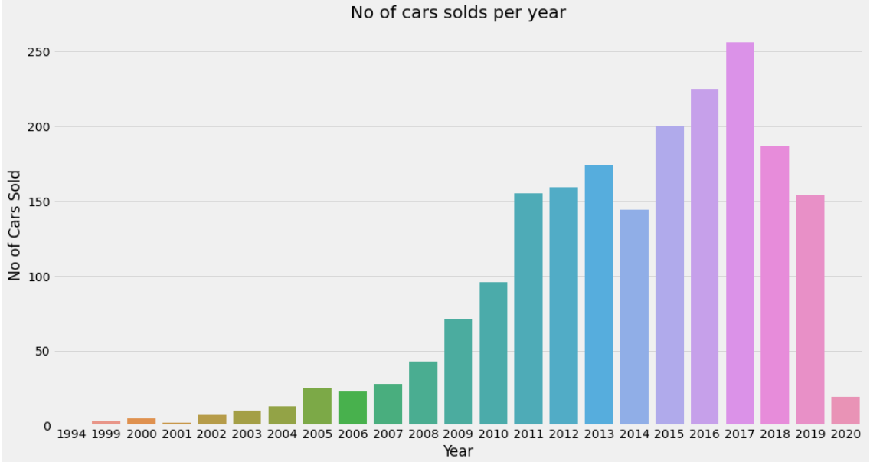
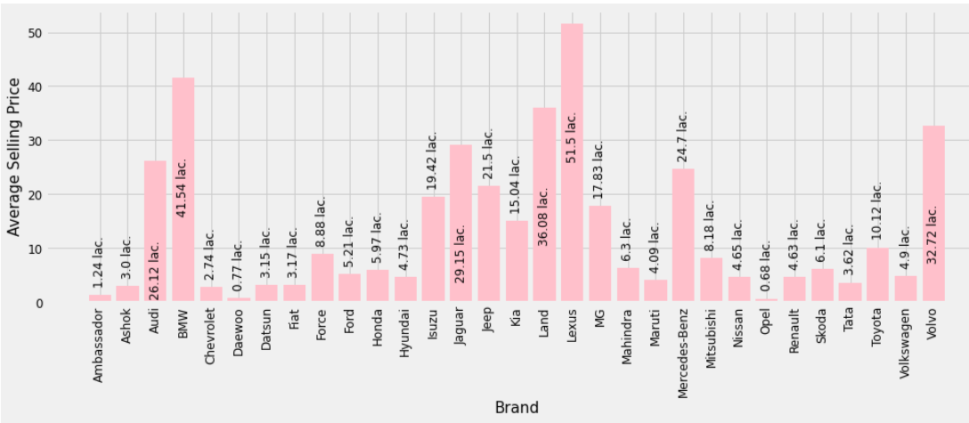
Task 2.2 (Exploratory Data Analysis)
Q1. Univariate, Bi- Variate Analysis and Multi- Variate Analysis.

Slide 8
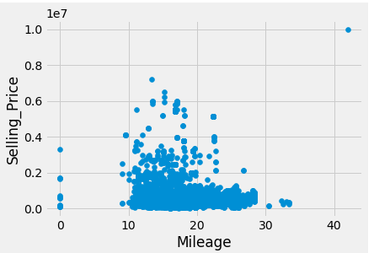
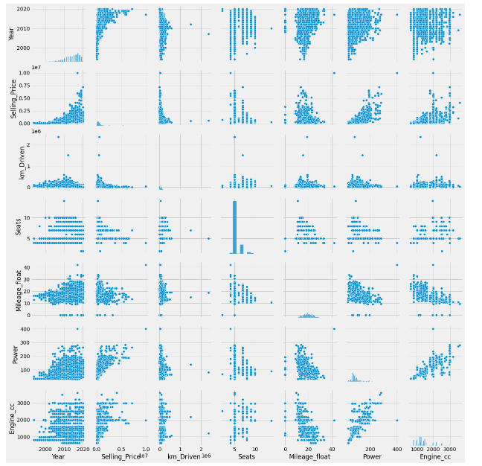
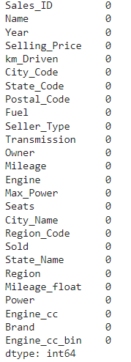
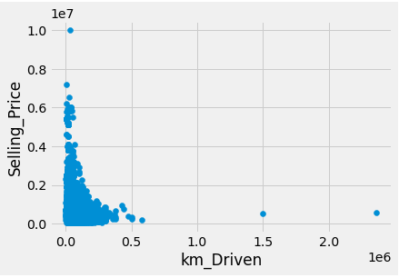
Task 2.2 (Exploratory Data Analysis) (Cont..)
Q2. Missing values identification and treatment
No Null Values
Q3 Outlier analysis and treatment.
Using pair plot, we saw two anomalies or outliers, in which there are some cars with 0 mileage and some cars with more Km Driven cars

Slide 9
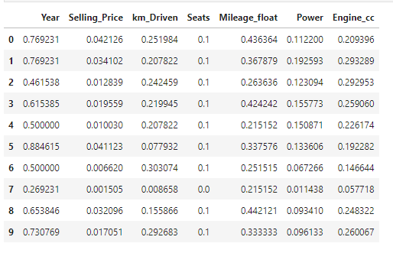
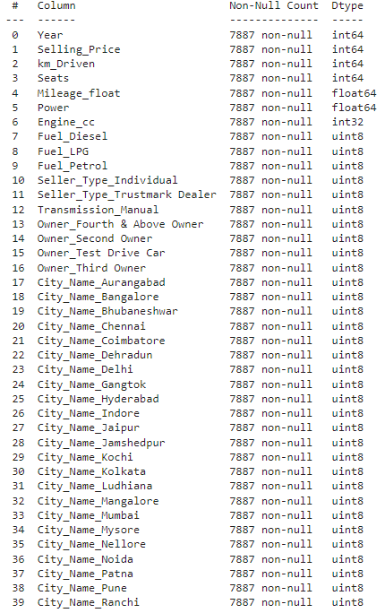
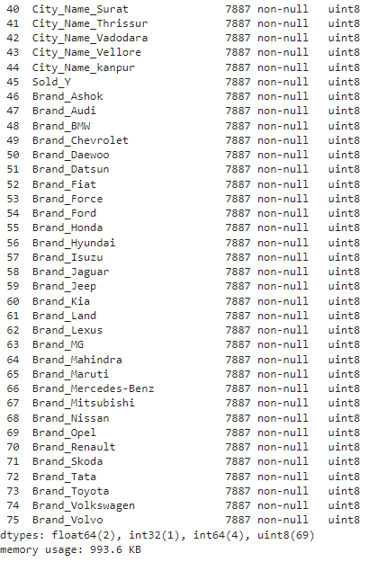
Task 2.2 (Exploratory Data Analysis) (Cont..)
Q4. Data scaling using min-max and/or Z-score normalization.
Q5. Data transformation

Slide 10
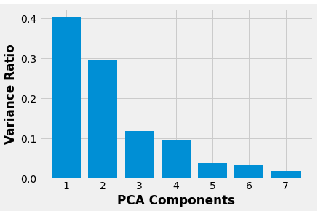
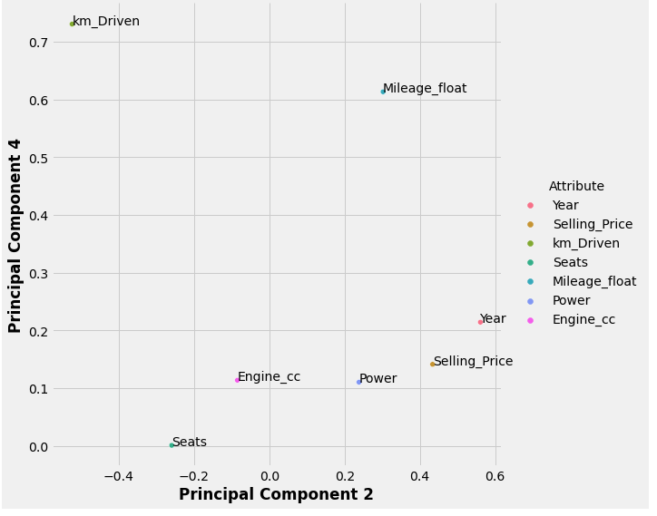
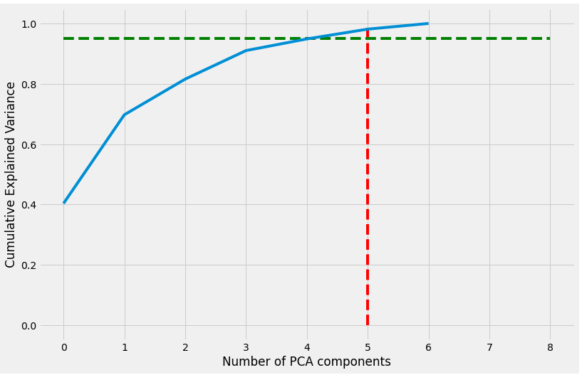
Task 2.2 (Exploratory Data Analysis) (Cont..)
Q6. Feature Engineering
Selling Price, Seats are well explained by PC_1 and PC_7.
Km Driven is well explained by PC_2 and PC_4
Mileage is well explained by PC_6
Power is well explained by PC_1 and PC_3
Engine is well explained by PC_1 and PC_7

Slide 11
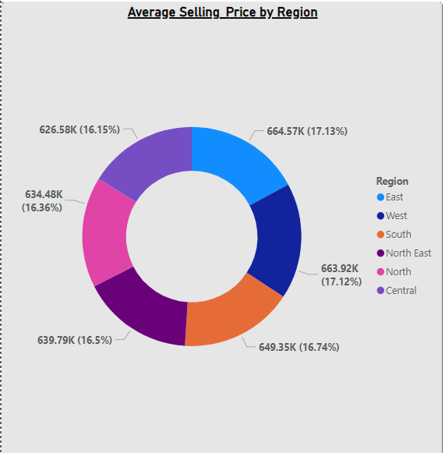
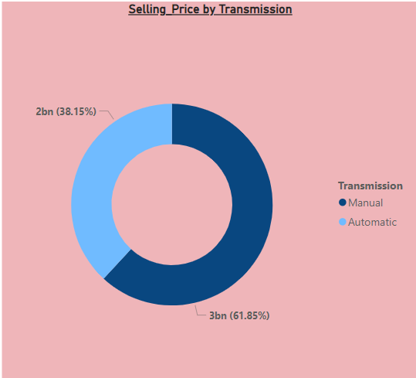
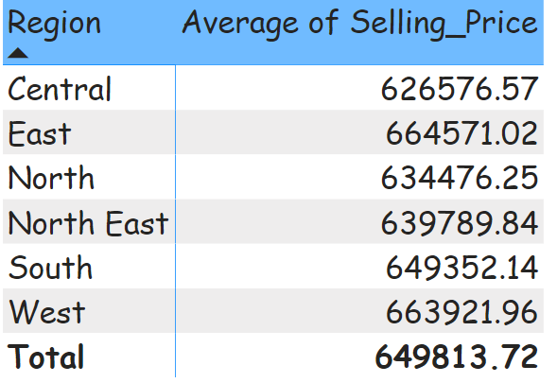
Task 2.3 (Visualization using Power-BI)
Q1. Identify the Region where the selling price is high.
In East Region, Average Selling Price is high.
Q2. Which Transmission type is generating the highest selling price ?
Average Selling Price of Manual Cars is high.
Q3. What is the average selling price by region?
Average Selling Price by Region

Slide 12
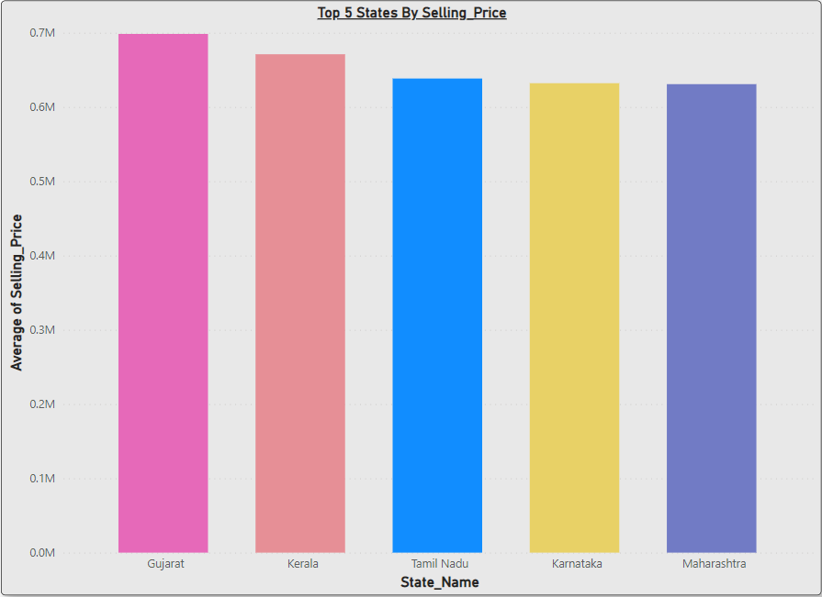
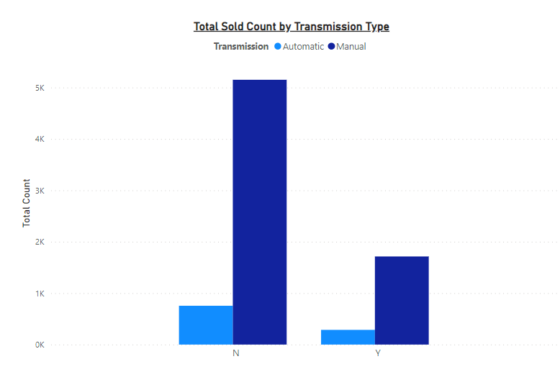
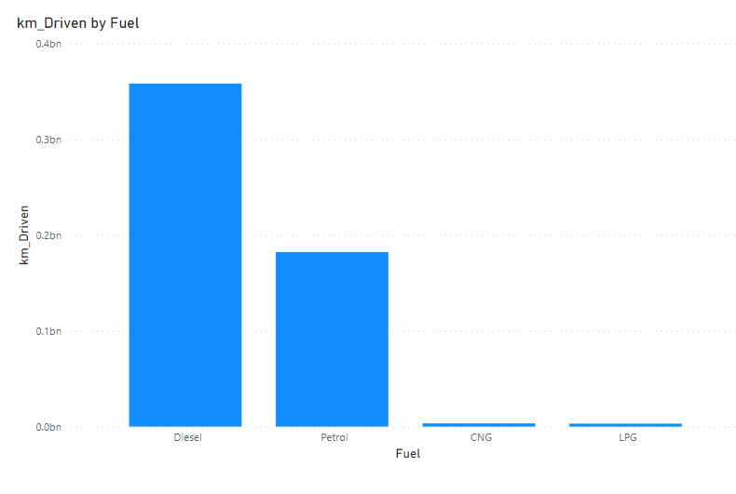
Task 2.3 (Visualization using Power-BI) (Cont..)
Q4. Identify the top 5 States where the selling price is high.
Top 5 states where average Selling Price is high – Gujarat -> Kerala -> Tamil Nadu -> Karnataka -> Maharashtra
Q5. Which transmission type vehicles were sold largely in number?
Manual cars were more sold.
Q6. Which fuel type vehicle has the highest KM Driven?
Diesel cars has highest KM Driven.

Slide 13
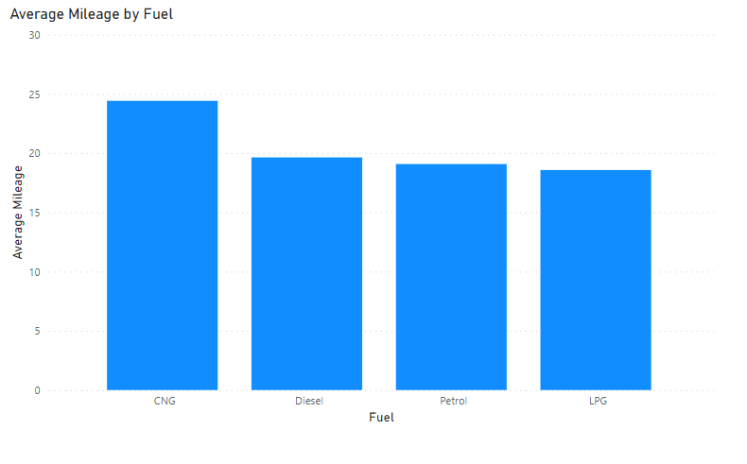
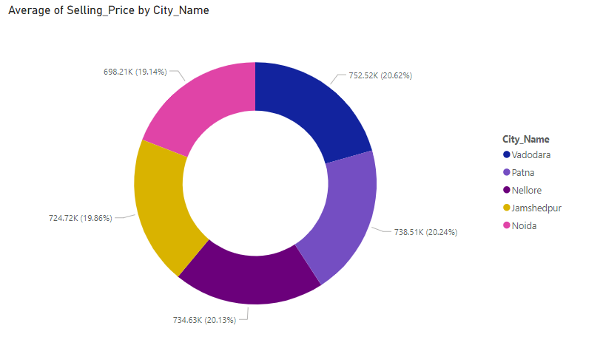
Task 2.3 (Visualization using Power-BI) (Cont..)
Q7. Visualize Average Mileage type by Fuel type.
CNG fuel cars are having high average Mileage.
Q8. Identify the cities where the used cars where the selling price was highest.
Vadodra city sold the car with highest average Selling Price.

Slide 14
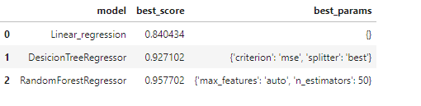


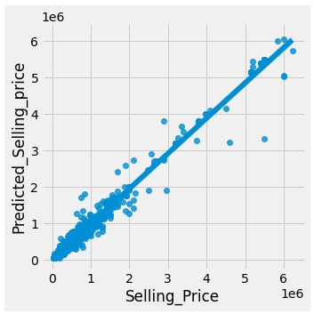
Task 2.4 (Model building using ML algorithms)
Q1. Build an appropriate ML model/s on the data.
We build Linear Regression, Decision Tree and Random Forest Regressor Model.
Q2. Compare various ML models with appropriate regularization and/or hyper-parameter tuning.
After applying hyper-parameter tuning, we concluded Random Forest Regressor Model.
Q3. Evaluate the performance of the model.
After evaluating our model was 97.7% accurate.
Q4. Identify the right metric to evaluate the performance of the model.
MSE and RMSE are the right metric to evaluate the performance of the model.
Q5. Identify issues and concerns on the given data and suggest the best technique/s to overcome the issues.
We didn't observer any overfitting or underfitting of the data so there are no concerns.

Slide 15
Team Contribution

Slide 16





Group Members
Harsh Singh
Hitesh Gulati
Lakshi Bansal
Miska Gowri Sankar
Satish Kanagala Naga

Slide 17
Thank you

Slide 18
About Deloitte
Deloitte refers to one or more of Deloitte Touche Tohmatsu Limited, a UK private company limited by guarantee (“DTTL”), its network of member firms, and their related entities. DTTL and each of its member firms are legally separate and independent entities. DTTL (also referred to as “Deloitte Global”) does not provide services to clients. In the United States, Deloitte refers to one or more of the US member firms of DTTL, their related entities that operate using the “Deloitte” name in the United States and their respective affiliates. Certain services may not be available to attest clients under the rules and regulations of public accounting. Please see www.deloitte.com/about to learn more about our global network of member firms.
Copyright © 2020 Deloitte Development LLC. All rights reserved.

